Slide 1
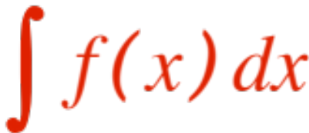
COMPUTING ANTI-DERIVATIVES
(Integration by SUBSTITUTION)
The computation of anti-derivatives is just an in-tellectual challenge, we know how to take deriv-atives, but …
can we invert the process? We call this
Computing the indefinite integral .
In the last presentation we have seen a few
indefinite integrals (we called them bricks), but they did not include the anti-derivative of many functions! We are going to try and do better !

Slide 2
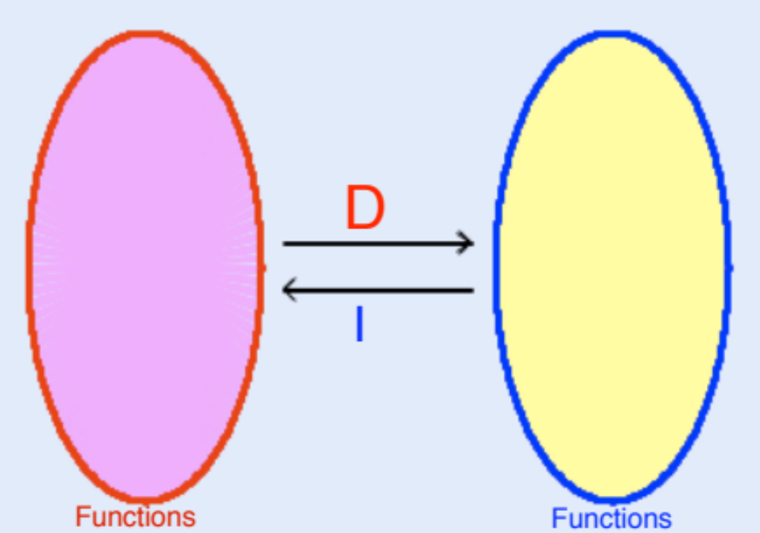
It pays off to look at differentiation and integration as inverse processes, that is, if we apply each in order we end up (essentially) where we started.
First D then I gives us “where we started + C”

Slide 3
First I then D gives us “where we started.”
This very simple observation is going to give us a fair amount of power, because we know how D works, and we can essentially take advantage of “undoing” it ! Here we go.

Slide 4


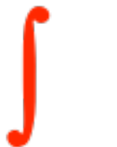
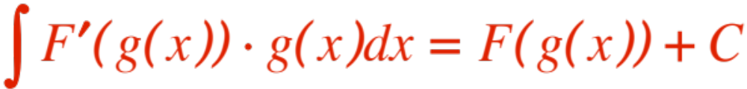
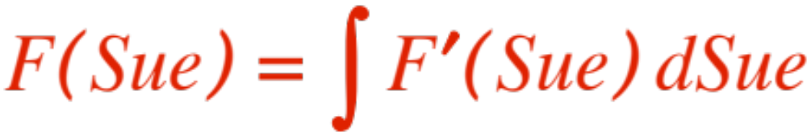
We know how the chain rule works. It says:
Apply to both sides (remember that
where you started (never mind C !). We get
Replacing the symbol with we get
Since we men- tally put

Slide 5
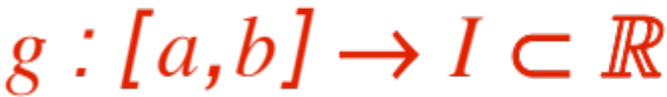
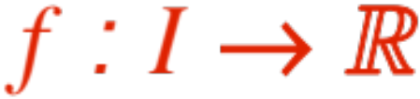
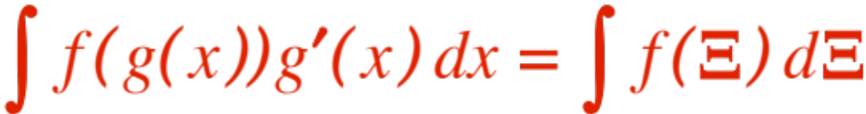
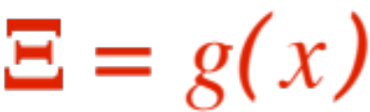
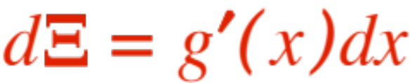
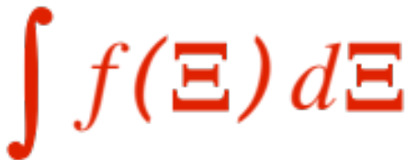
And get the following
Rule of Integration by Substitution:
If is differentiable, and
is differentiable, then
where and .
We say we use the substitution .
The advantage is that the integral
may be a lot easier than the one we started with.

Slide 6
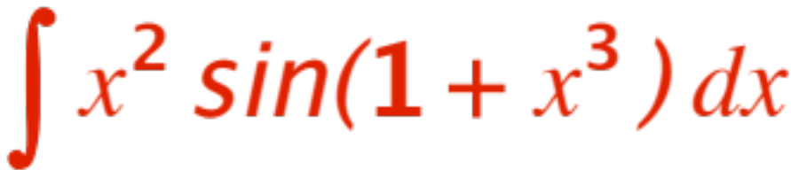
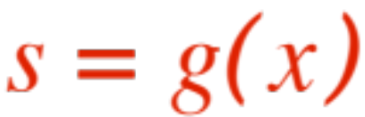

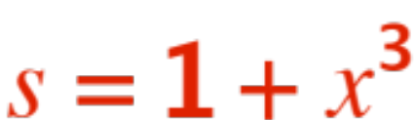
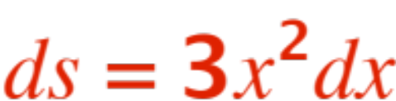
An example is in order. Let’s compute
When using substitution there are several choices for what to call (I have dropped !)
You will only learn which choices are smart and which ones are not by doing very, very many ex-amples, making very, very many not so smart choices.
I have already gone through that, so I know that the smart choice here is . We get

Slide 7
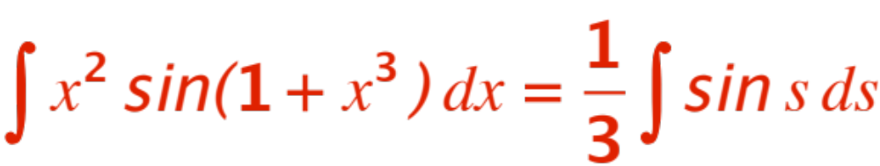
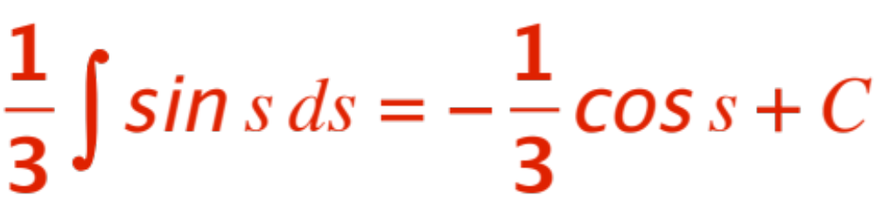
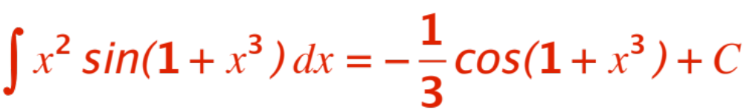
And therefore
The last integral is easy!
Putting the pieces together (writing )
We get
(Check it out !) More examples on the board.

Slide 8
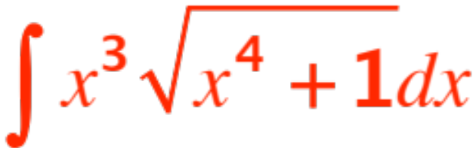
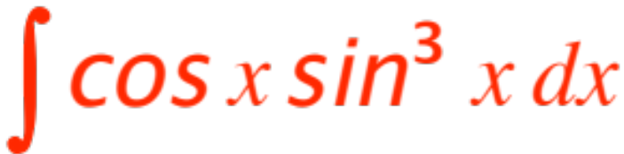
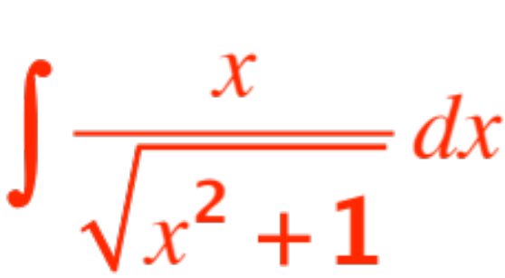
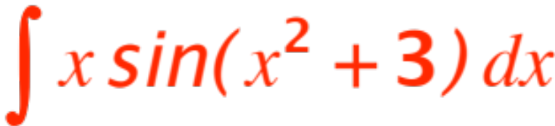
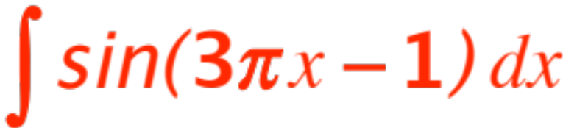
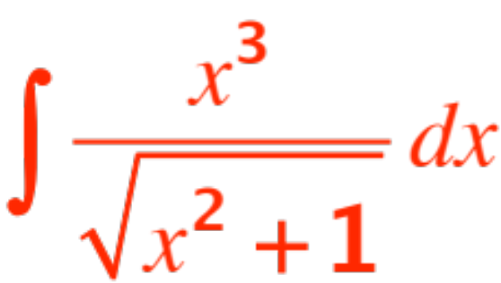
Here are a few:
and the hardest

Slide 9
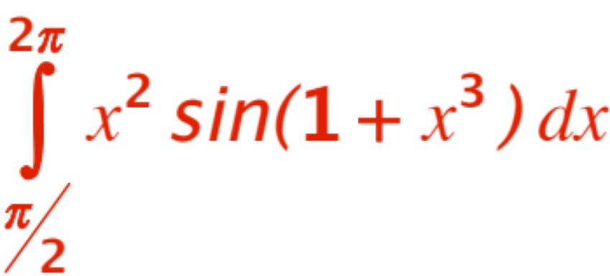
How do we use substitution to compute
? (a definite integral)
Two choices.
The formula
gives rise to

Slide 10
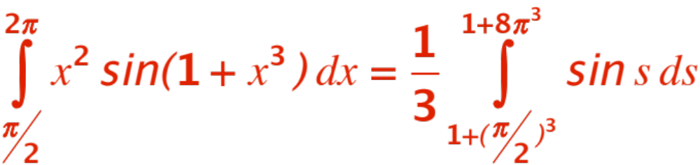



Or
Use the answer you got (in ), evaluate at
and as usual.
More examples on the board.

